Slide 1
Natural LANGUAGE PROCESSING
NLTK library
Wrocław, 05.01.2021

Slide 2
What is NLTK?
https://www.nltk.org/
https://www.nltk.org/book/
Natural language processing (NLP) is a field that focuses on making natural human language usable by computer programs. NLTK, or Natural Language Toolkit, is a Python package that you can use for NLP.

Slide 3
Getting started
python -m pip install nltk
Standard stages of test analysis:
Tokenizing
Word filtering
Stemming
Tagging part of speech
Lemmatizing
Final analysis (frequency distribution, dispersion plots etc.)

Slide 4
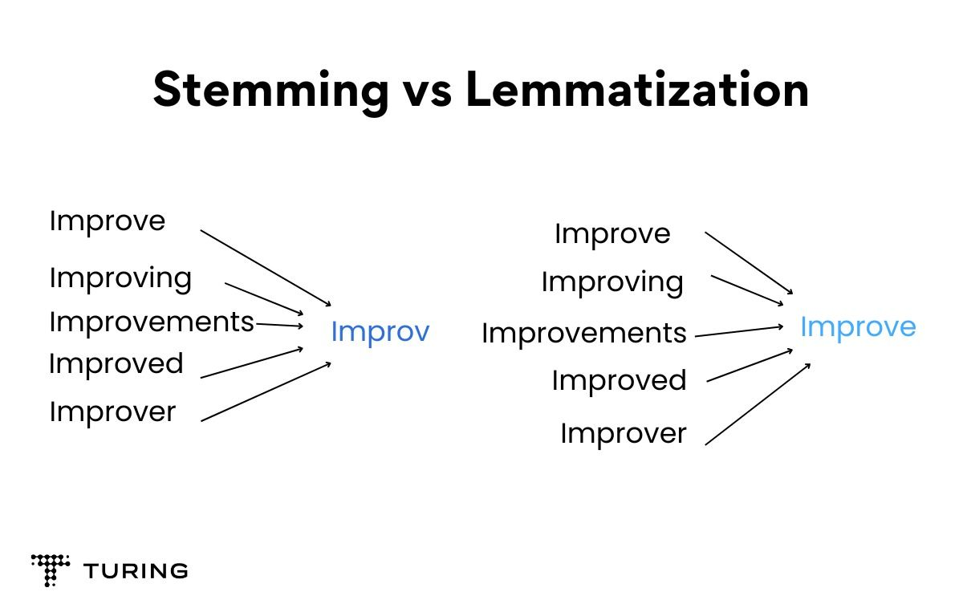

Slide 5
Tokenizing
By words
By sentences

Slide 6
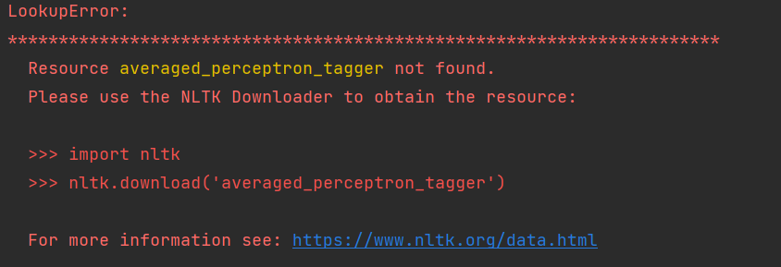

Slide 7
